Slide 1

WEEKLY REPORT
Unitree G1
Coordinated locomotion and manipulation
Evidence • Mission alignment • Problems and solutions
Prepared by Shih-Kai Lan
Reported to Professor Zhao and Zhengyu Wu
13 September 2026

Slide 2
EXECUTIVE ANSWER
What is complete — and what is not yet proven
5 of 6
Completed
Pending fair proof
Repository and README study
CUDA runtime and datasets
Controller playback
Reward implementation
Saved model_499.pt
The laptop used 1,024 environments, one eighth of the requested 8,192. Equal iteration numbers are not equal training budgets.
mission deliverables complete
Evidence-first rule
Execution is verified. Higher accuracy remains an open, sample-matched experiment.
SHIH-KAI LAN • GEORGIA TECH • UNITREE G1 RESEARCH

Slide 3
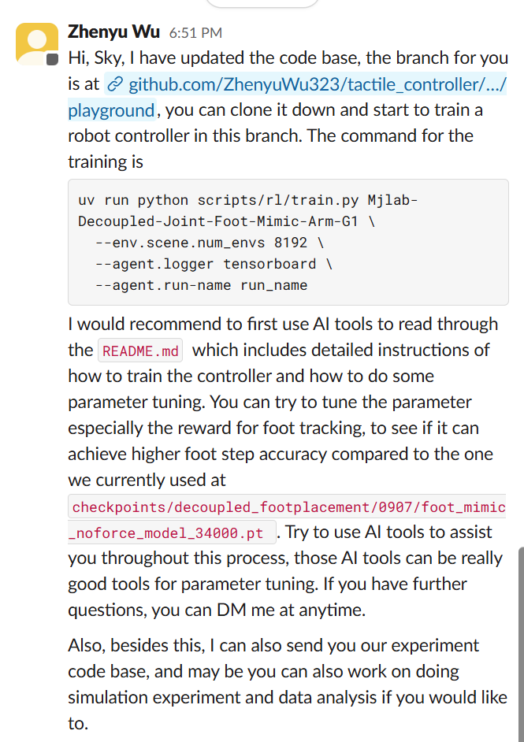
ORIGINAL DIRECTION
Zhengyu Wu’s mission
1
Train
Use the playground branch and run Foot Mimic Arm G1.
2
Tune
Focus on the foot-tracking reward.
3
Compare
Test whether footstep accuracy exceeds the supplied checkpoint.
4
Use AI
Read the README and use AI for parameter tuning.
SHIH-KAI LAN • GEORGIA TECH • UNITREE G1 RESEARCH
Notes:
Source: user-supplied Slack screenshot from Zhengyu Wu, 13 September 2026.

Slide 4
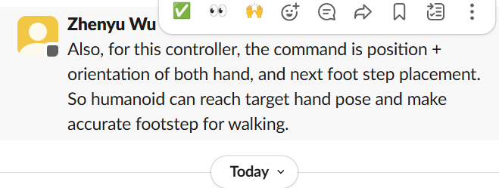
TASK INTERFACE
What the controller is commanded to do
L
Left hand
R
Right hand
F
Next footstep
3D position + 3D orientation
3D position + 3D orientation
Position and walking target
Objective: reach both hand poses while placing the foot accurately and preserving balance.
SHIH-KAI LAN • GEORGIA TECH • UNITREE G1 RESEARCH
Notes:
Source: user-supplied Slack screenshot from Zhengyu Wu, 13 September 2026.

Slide 5
ALIGNMENT
Mission audit
Playground branch
Commit 21aed05
COMPLETE
README and source study
Task, data, reward, metric map
COMPLETE
Train controller
2 smoke tests + saved model_499.pt
COMPLETE
Tune foot reward
Added σ 0.05 m precise kernel
COMPLETE
Command interface
Both hands + next footstep verified
COMPLETE
Higher accuracy
Needs sample-matched A/B + playback
PENDING PROOF
SHIH-KAI LAN • GEORGIA TECH • UNITREE G1 RESEARCH

Slide 6
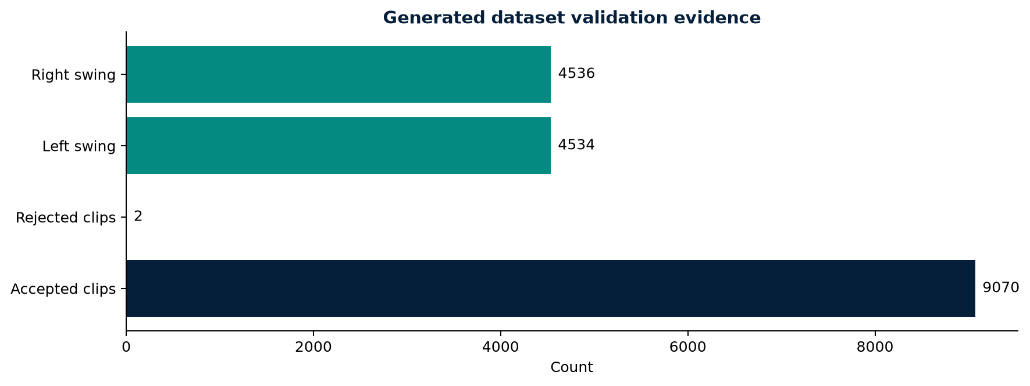
DATA EVIDENCE
The experiment produced traceable evidence
9,070
99.98%
1,296
2.999 mm
accepted clips
acceptance rate
command cells
max foot IK residual
Physical validation
Landing error max
0.000000021 m
COM residual max
0.515 mm
ZMP error max
1.000 cm
SHIH-KAI LAN • GEORGIA TECH • UNITREE G1 RESEARCH
Notes:
Sources: data/foot_lip_v2/eval_report.json and generation summary.

Slide 7
DATA METHODOLOGY
How the walking dataset was verified
1
2
3
4
Generate
Solve
Gate
Audit
Sample commanded foot placements across the grid.
Construct trajectories and solve foot and COM inverse kinematics.
Reject clips that violate IK, landing, ZMP, or spacing limits.
Measure coverage, swing balance, and error distributions.
9,070 usable clips • 1,296 cells • left/right difference of only 2 clips
Validation outcome
Training evidence is only meaningful when its reference commands are complete and physically valid.
Why this matters
SHIH-KAI LAN • GEORGIA TECH • UNITREE G1 RESEARCH

Slide 8
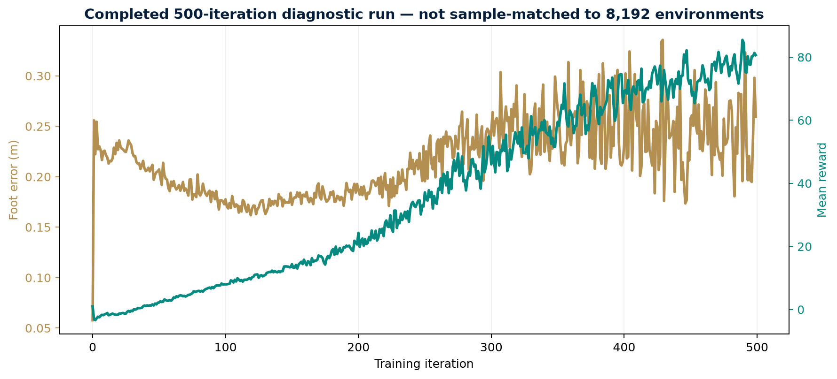
TENSORBOARD EVIDENCE
The 500-iteration diagnostic run completed
499
latest iteration
80.7
mean reward
410.1
mean episode length
DIAGNOSTIC COMPLETE
Saved model_499.pt. Accuracy proof still needs sample matching.
SHIH-KAI LAN • GEORGIA TECH • UNITREE G1 RESEARCH
Notes:
Source: TensorBoard event log in /mnt/c/Users/gigabyte/Documents/ChatGPT/GT research/logs/rsl_rl/g1_decoupled_joint_foot_mimic_arm/2026-09-13_22-38-08_foot_precise_s005_500. Captured through iteration 499.

Slide 9
REPRODUCIBILITY
Exact training configuration
Task
Mjlab Decoupled Joint Foot Mimic Arm G1
Environments
1,024 parallel simulations
Iterations
500
Logger
TensorBoard
Seed
42
Run name
foot_precise_s005_500
Why 1,024?
The requested 8,192 setting assumes more VRAM; this laptop has 8 GB.
SHIH-KAI LAN • GEORGIA TECH • UNITREE G1 RESEARCH

Slide 10
FAIR COMPARISON
The sample budgets are not equivalent
12.29M
98.30M
8×
environment steps
500 × 1,024 × 24
environment steps
500 × 8,192 × 24
reference sample ratio
Observed laptop result
README reference
Correct conclusion
25.9 cm final
24.3 cm final-20 mean
6.4 cm at iteration 500
The diagnostic run executed, but the first result does not prove higher accuracy. Run matched A/B tests or about 4,000 iterations at 1,024 environments.
SHIH-KAI LAN • GEORGIA TECH • UNITREE G1 RESEARCH

Slide 11
EVIDENCE INTERPRETATION
What the reported metrics mean
Foot-position error
Distance between commanded and achieved foot locations. Lower is better.
Mean episode length
Duration before termination. Growth usually indicates improving stability.
Fell-over termination
Safety guardrail showing episodes ended by falling. Lower is better.
Mean reward
Optimization signal across reward terms. It cannot replace physical accuracy.
Hand errors
Position and orientation accuracy for both commanded end effectors.
Interpretation rule
No single metric is sufficient; accuracy, stability, safety, and playback must agree.
SHIH-KAI LAN • GEORGIA TECH • UNITREE G1 RESEARCH

Slide 12
EXPERIMENT DESIGN
One controlled reward change
BASELINE
TUNED
Broad foot-position kernel
Broad kernel retained
+
σ = 0.20 m • weight = 1.0
+ precise kernel
σ = 0.05 m • weight = 1.0
Hypothesis
The broad signal supports early learning; the narrow signal rewards centimetre-level accuracy.
Decision rule
Keep the change only if foot error falls without more falls, shorter episodes, or worse hand tracking.
SHIH-KAI LAN • GEORGIA TECH • UNITREE G1 RESEARCH

Slide 13
COMPARISON BASELINE
The reference defines the proof threshold
500-iteration gate
6.4 cm
reference foot error
35,500 iteration
3.0 cm
mature reference
Laptop result: 25.9 cm final, but with 8× fewer samples per iteration.
SHIH-KAI LAN • GEORGIA TECH • UNITREE G1 RESEARCH
Notes:
Source: tactile_controller README reference metrics at commit 21aed05 and the completed local TensorBoard run.

Slide 14
ENGINEERING OBSTACLES
Problems, solutions, and proof
1
Windows CUDA wheel
Move locked environment to WSL
JAX sees RTX 5070 CUDA device
2
Missing compiler / libgomp
Install user-space build tools
221 packages synchronized
3
Missing foot dataset
Generate and validate all candidates
9,070 of 9,072 accepted
PROBLEM
SOLUTION
VERIFICATION
SHIH-KAI LAN • GEORGIA TECH • UNITREE G1 RESEARCH

Slide 15
EXPERIMENTAL RISKS
Problems, solutions, and proof
4
8 GB GPU limit
Use 1,024 instead of 8,192 environments
500 iterations complete; model_499.pt saved
5
Unequal sample budgets
Compute environment steps, not iteration count alone
Matched A/B or about 4,000 iterations required
6
AI can overclaim
Use source as authority; label uncertainty
Mission audit keeps accuracy proof pending
A solved problem is not complete until the fix is verified.
SHIH-KAI LAN • GEORGIA TECH • UNITREE G1 RESEARCH

Slide 16
TIMELINE
Recent weeks — a shift toward controlled experiments
1
2
3
4
Early August
August
Late August
12–13 September
Rough-terrain G1 workflow
and checkpoint continuation
3 m edge-return behavior
and model_3000.pt
13-file team package
and GT LIDAR reconnection
Tactile controller, datasets,
playback, and reward tuning
I moved from making a controller work toward designing experiments that can explain why performance changes.
Main development
SHIH-KAI LAN • GEORGIA TECH • UNITREE G1 RESEARCH

Slide 17
METHOD
How I discuss research with AI
1
2
3
4
5
Ground
Hypothesize
Smoke test
Measure
Interpret
README • source • task • checkpoint
One parameter • expected tradeoff
Cheap failure detection
Physical errors • safety metrics
Playback • caveats • decision
AI role
Read, troubleshoot, propose, execute, organize.
My role
Verify sources, control the experiment, inspect behavior, and own the conclusion.
SHIH-KAI LAN • GEORGIA TECH • UNITREE G1 RESEARCH

Slide 18
DECISION GATES
What happens next
01
Run matched A/B
Use baseline and tuned rewards with identical 1,024-environment budgets.
02
Match samples
Extend toward 4,000 iterations or use a larger GPU for 8,192 environments.
03
Playback
Check center, edge, forward, backward, lateral, and rotated steps.
04
Decide
Retain the reward only if accuracy improves without guardrail regression.
Current assessment: mission aligned, model_499.pt saved, higher-accuracy claim not yet proven.
SHIH-KAI LAN • GEORGIA TECH • UNITREE G1 RESEARCH

